Slide 2
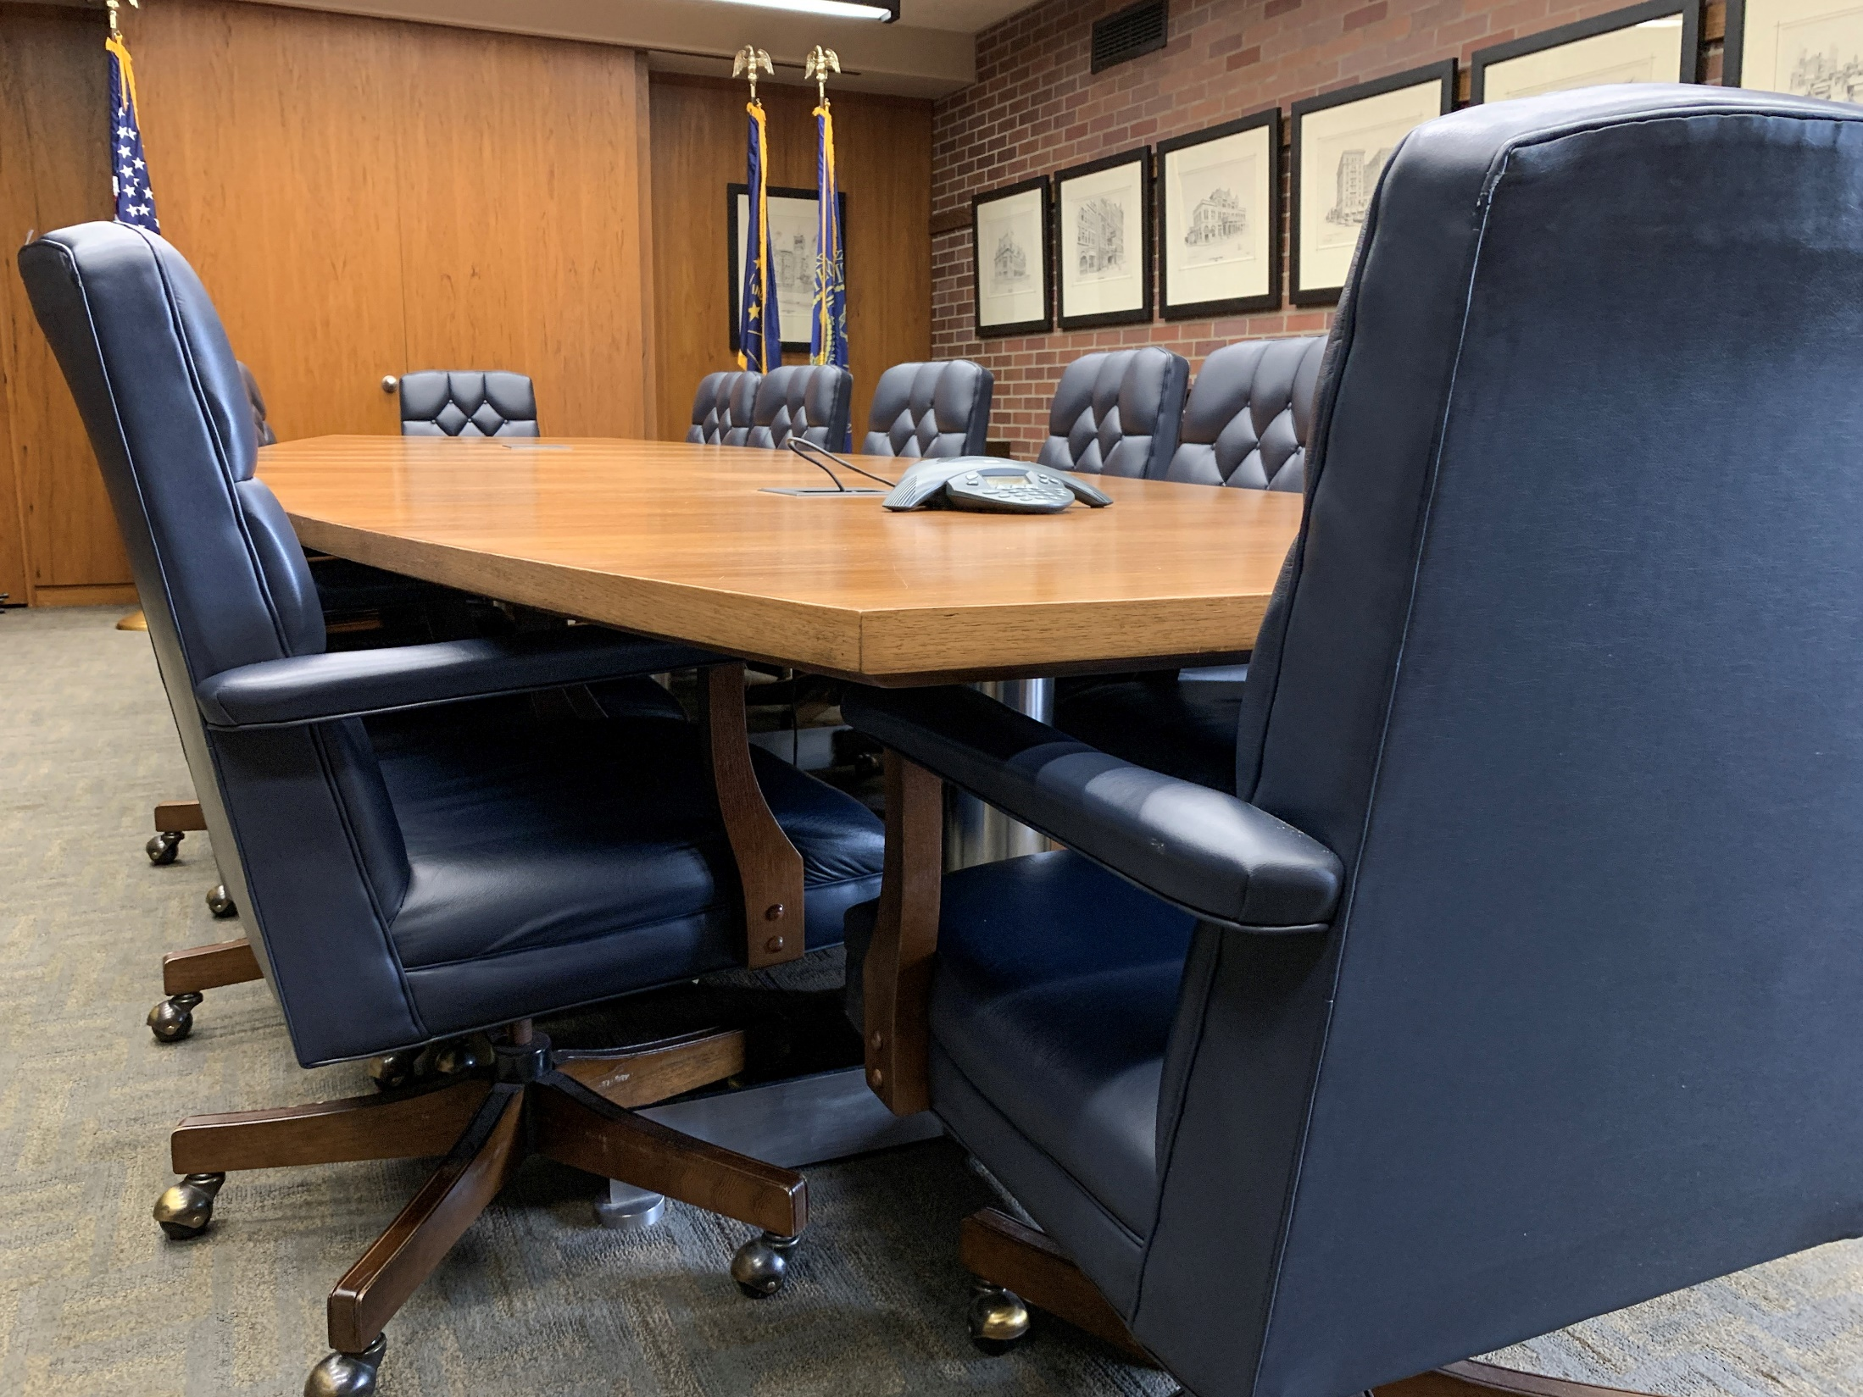
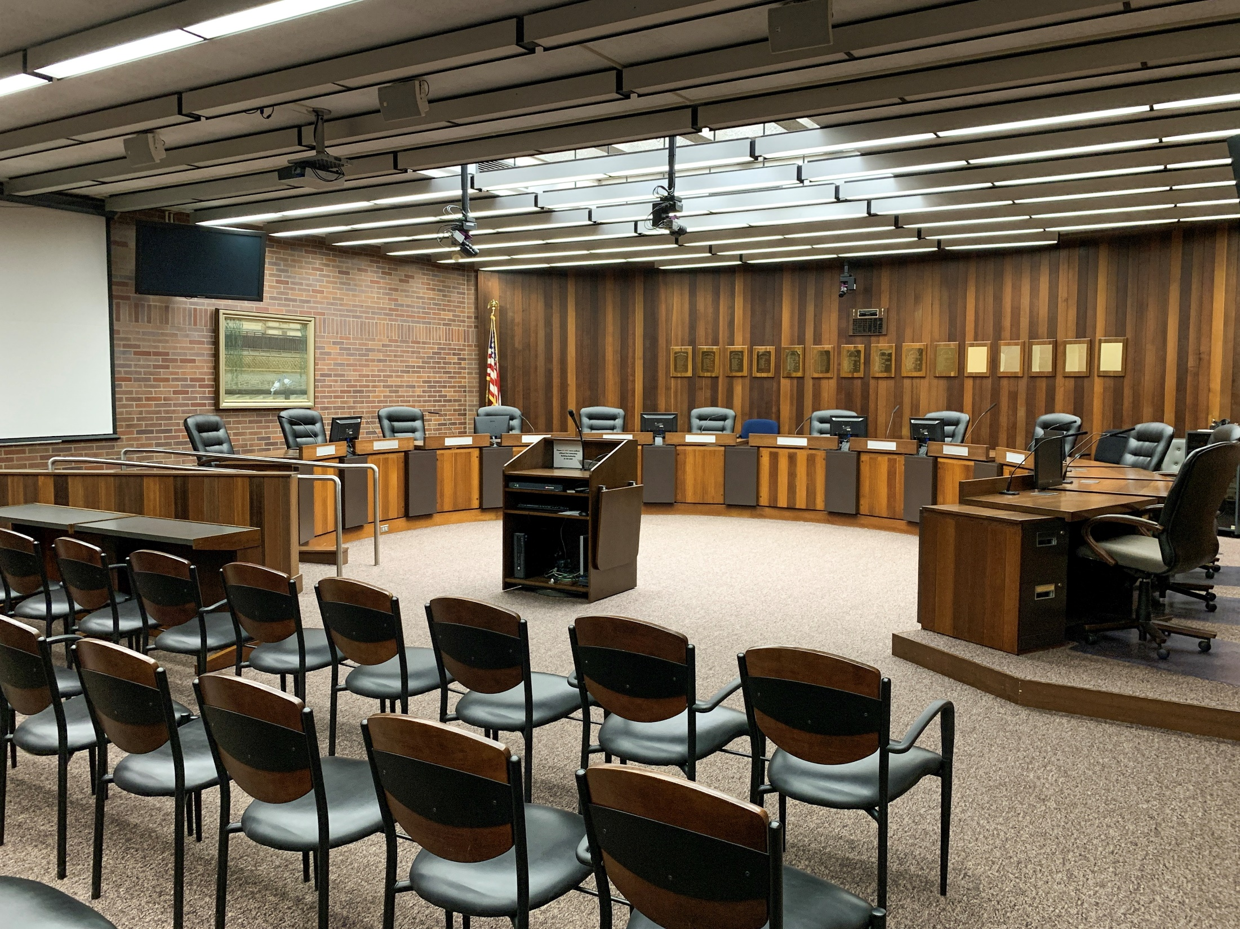
The Process
Staff started budget process in May
Administration met with each department in June
Follow up meetings, refinement and printing in July
Today (August 12) starts the budget hearing
Joint budget hearing August 20
Salary ordinance — first reading — September 9
Salary ordinance — second reading — September 23
Final budget adoption October 14

Slide 3
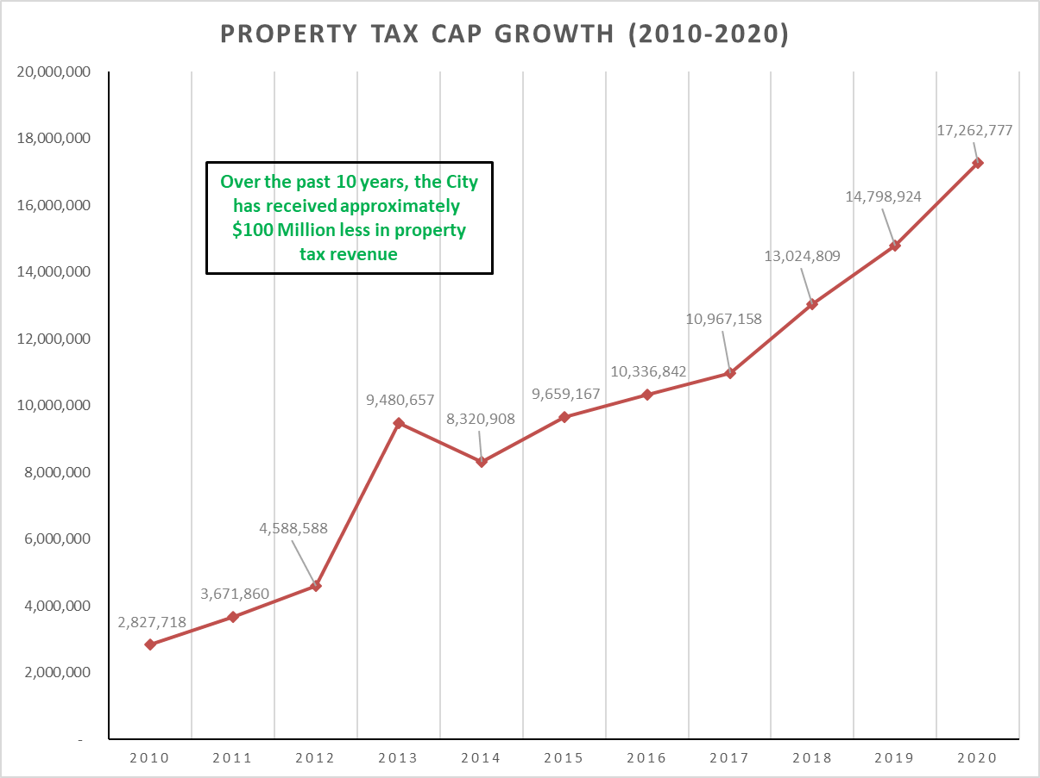
Property Tax Caps

Slide 4
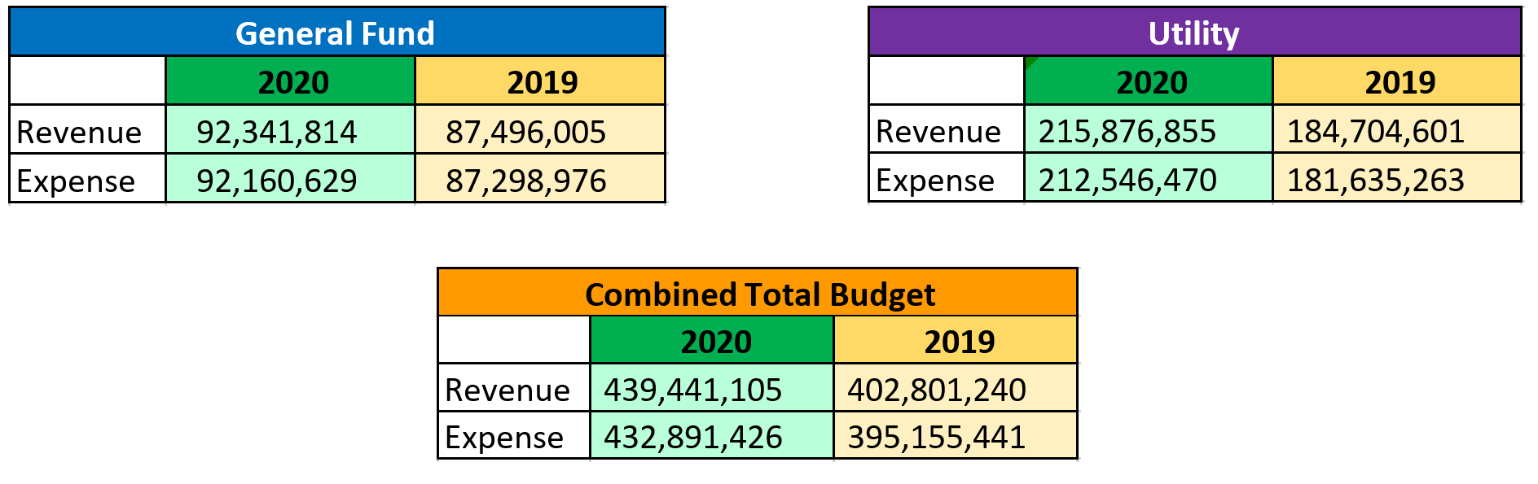
Budget Summary

Slide 5
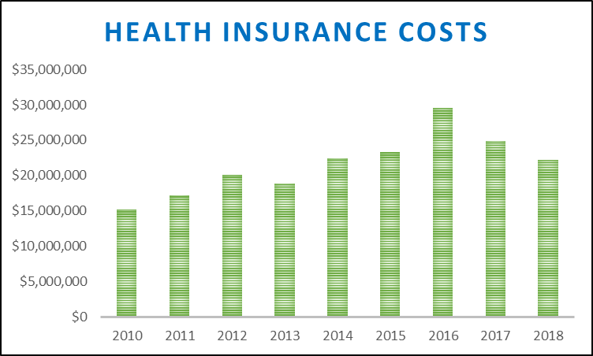
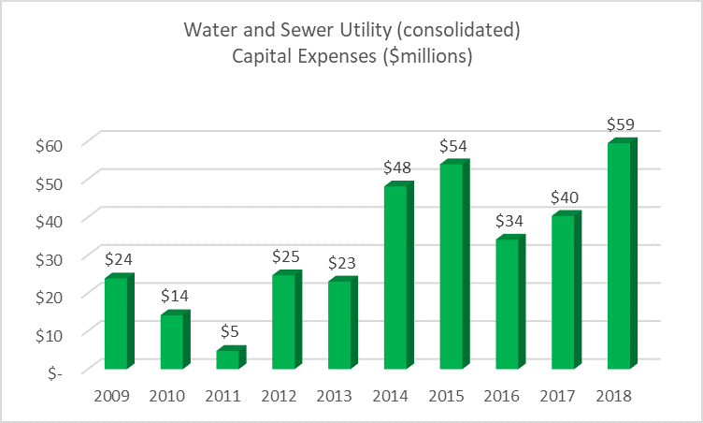
Cost Drivers

Slide 6
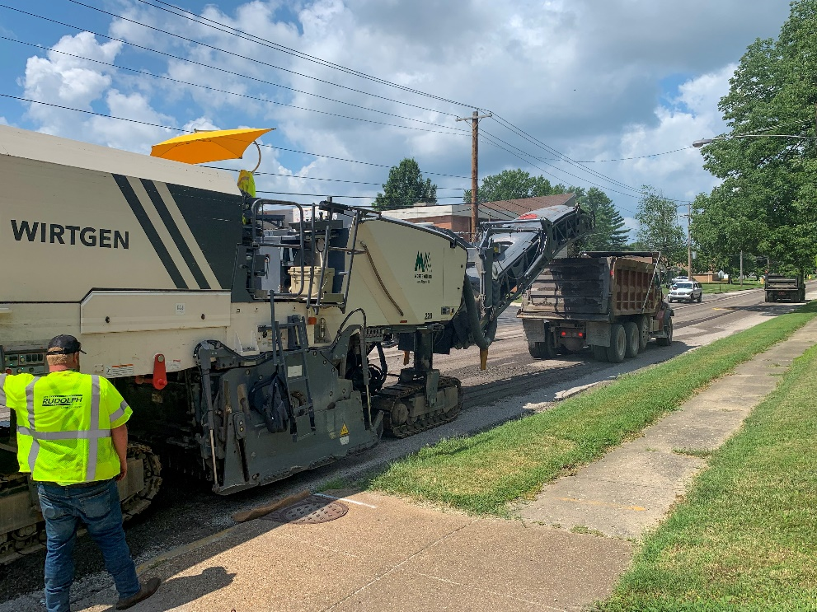
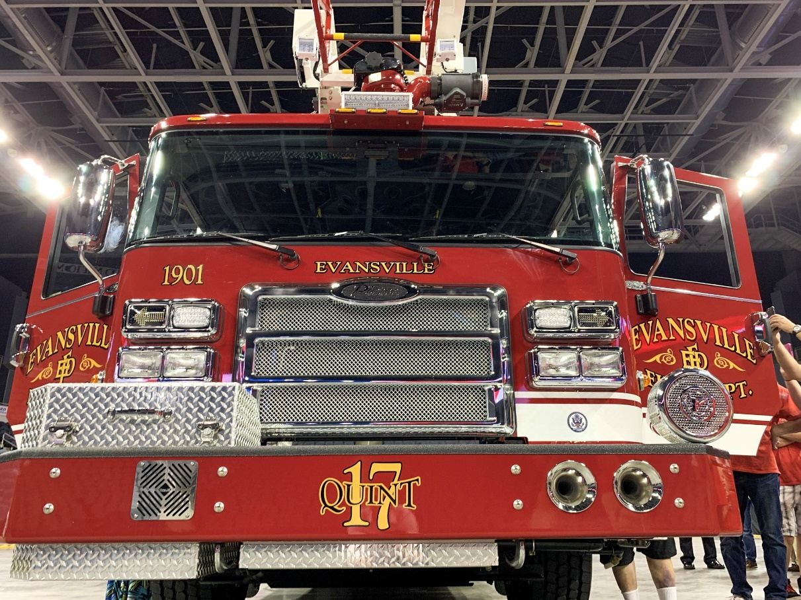
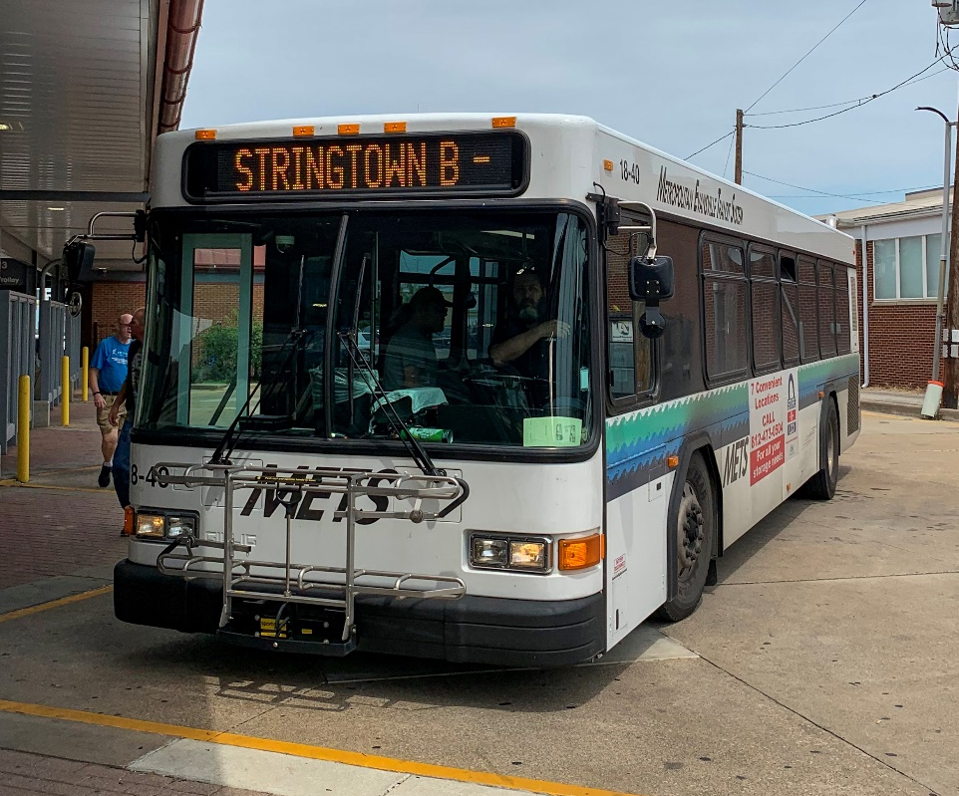
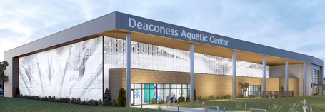
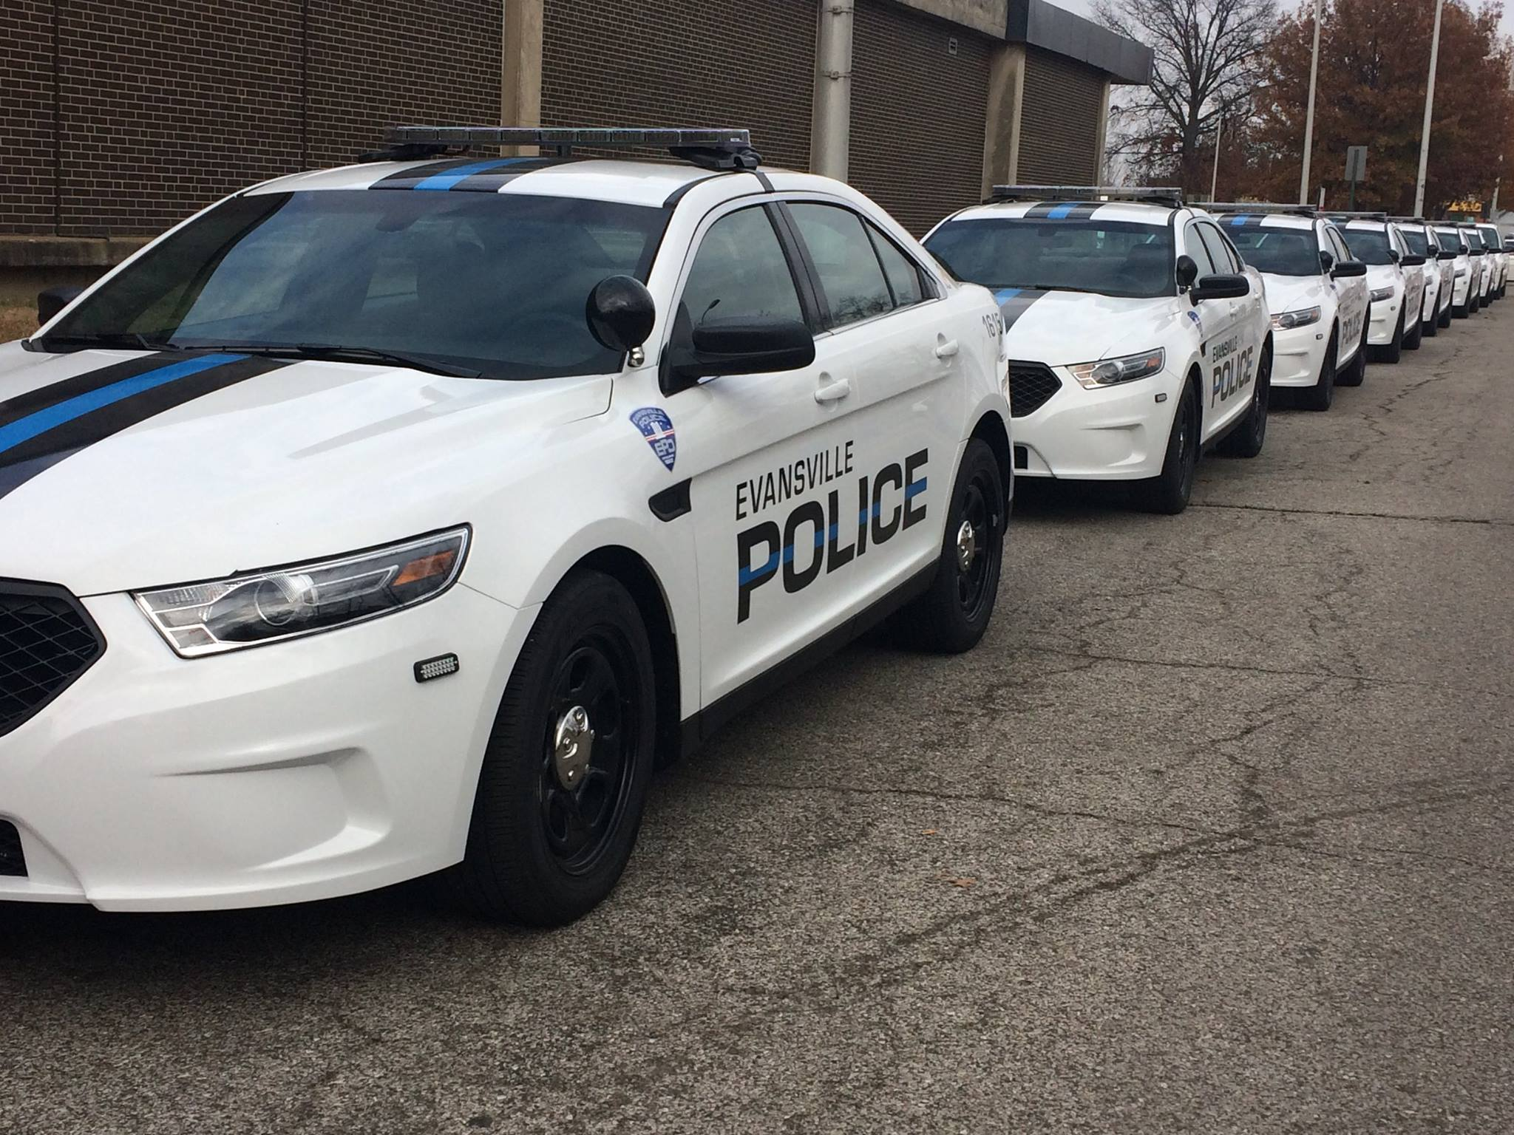
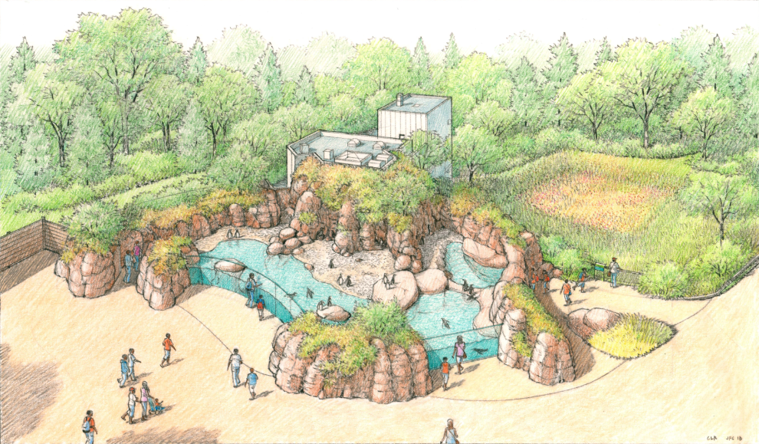
Capital Projects
Replacement of fire department aerial truck
Replace fire department self-contained breathing apparatus
Purchase new police cars
Replace body cams and software
METS buses
Deaconess Aquatic Center construction
Mesker Park Zoo Kinney Family Penguin Exhibit
Street resurfacing
Walnut Street corridor project (Regional Cities)
Covert Avenue Road Diet
Land Banking
Affordable Housing Trust Fund

Slide 7
Timeline
Hearing begins today
Salary ordinance on September 9 and 23
Final budget adoption October 14

